Slide 1
Business of Platforms: Network Structure Basics (version 11/11/2022)
Easley and Kleinberg. See http://www.stern.nyu.edu/networks/E&K/networks-book-ch01.pdf to -ch24.pdf
Read chapters 1 to 4
Sanjeev Goyal, Connections, Princeton University Press, 2007
Read Chapter 2

Slide 2
Networks are composed of complementary nodes and links
The crucial defining feature of networks is the complementarity between the various nodes and links
A service delivered over a network requires the use of two or more network components
Thus, network components are complementary to each other

Slide 3
Example: the Information Superhighway (1994)

Slide 4
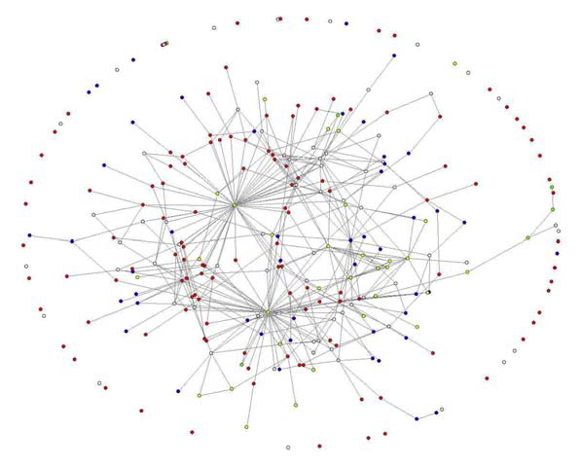
Network structure
Nodes: entities
Edges/links: relationships
Directed or not
Features/colors of nodes
Features of links

Slide 5

Human connections networks
Co-authors
Facebook
Blog readers
Members in
organizations
political parties
professions
How important is a specific node?
Strong and weak ties
Cohesion issues
What holds the network together?
Activity on networks
How does it get affected by the network structure?
Is behavior influenced by network nearness? How?

Slide 6
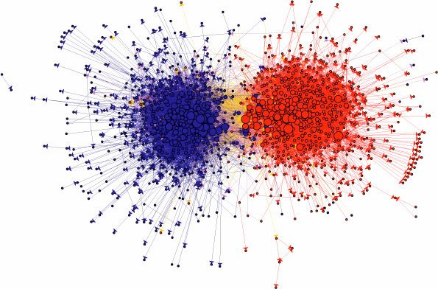
Polarization in blogs in the 2008 presidential campaign

Slide 7
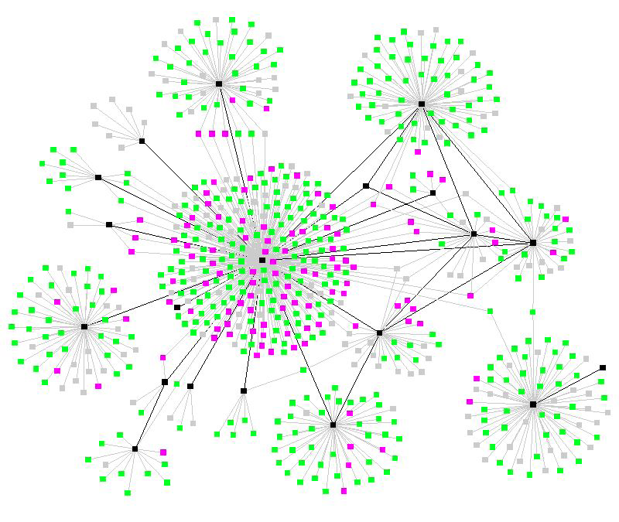
Spread of an epidemic

Slide 8
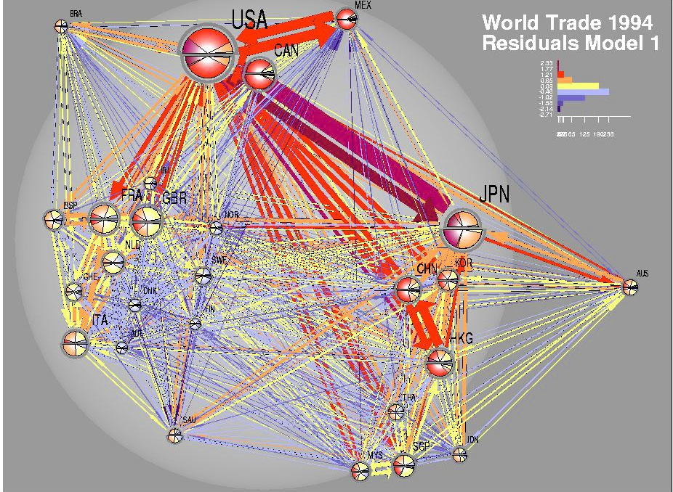
World trade network example from Easley and Kleinberg, Figure 1.8

Slide 9
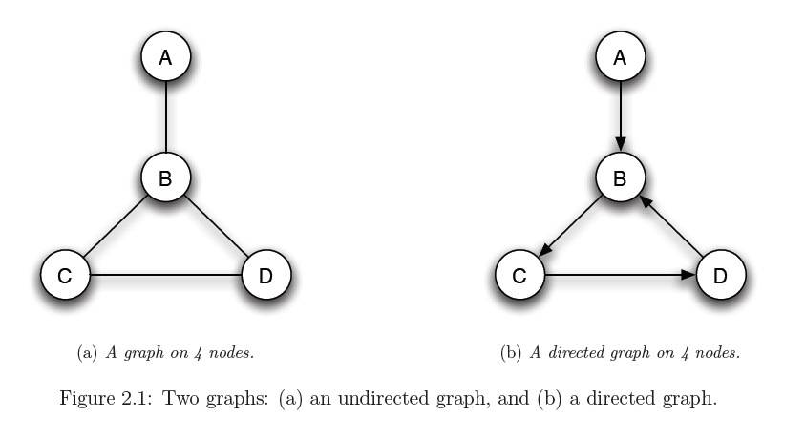
Network structure: Undirected and directed graphs

Slide 10
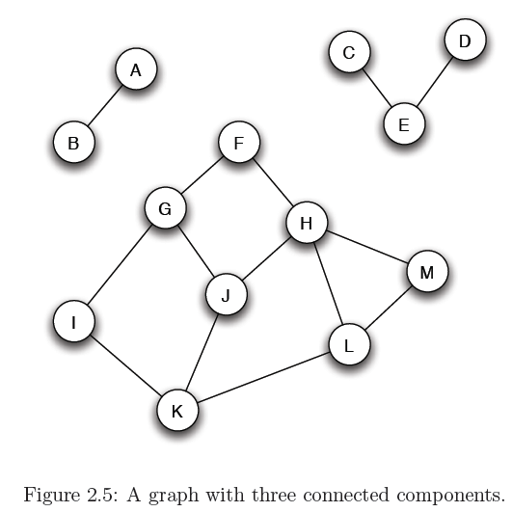
Network structure: Connected components

Slide 11
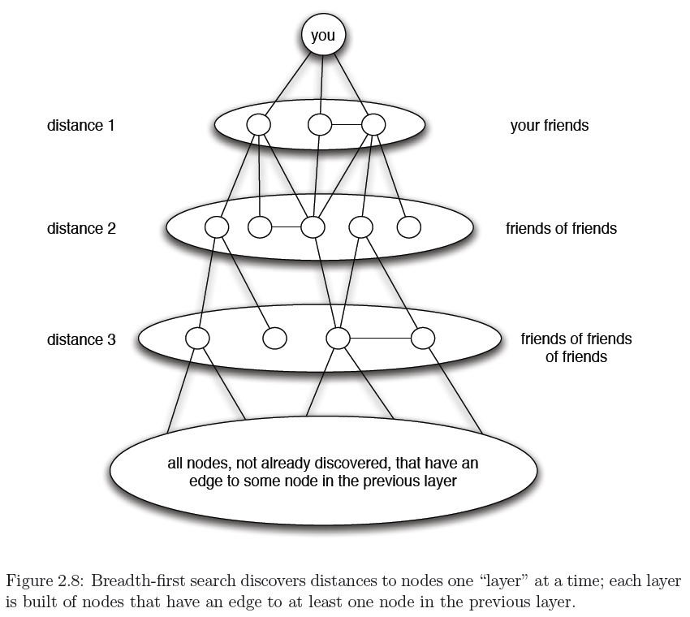
Network structure: Breadth-first search

Slide 12
A Simple Social Network With Three Components
C
C is an isolated node
D
A is a node with a high degree of centrality
B and E are not connected, but there is a path between them.
A and E are connected.
A
A and D are also not connected and there is no path between them.
E
B

Slide 13
A Star (Hub & Spoke) Airports Network
SEA
JFK
ORD
ATL
LAX

Slide 14
A complete network: All nodes directly connected with each other
SEA
JFK
ORD
ATL
LAX

Slide 15
Competing Platforms
The Ms are multi-homing; that is, they belong to both networks (connect to more than one platform).
M₁
C₁
P₁
M₂
C₂
M₃
C₃
There is no interconnection between the networks
M₄
C₄
P₂
M₅
C₅
The Cs are single homing; that is, they belong to just one network (connect to a single platform).
M₆
P₁ and P₂ are the platforms
(e.g., payment-card networks)

Slide 16
Competing Platforms with Interconnection (e.g., telecom)
P₁ or P₂ may need to pay the other an interconnection fee
C₆
C₁
P₁
C₇
C₂
C₈
C₃
C₉
C₄
P₂
C₅ and C₉’s conversation is on net.
C₁₀
C₅
C₅ and C₆’s conversation is off net.
C₁₁

Slide 17
Basic structure of the Internet: arrows indicate payment flows. Green arrows: money to platform (IB)
ISP
ISP
Netflix
Google
Internet Backbone
Business Customers
ISP
ISP
(Residential
Access Network)
Internet backbone companies: AT&T, Verizon, others
R: subscription price
Residential Customers

Slide 18
Concepts, Goyal pp. 9-24
“Neighbors” of j are those nodes with direct links to j
A network is “regular” if every node has the same number of links
“Degree” of node j is the number of direct connections of j = number of neighbors of j
A, C, D: neighbors of B
Degree of
A is 1
B is 3
C is 2
D is 2
D
C
A
B

Slide 19
Degree distribution
is a n-long vector of the number of nodes with degree k (= 1, …, n)
Variance of the degree distribution
Range of degrees
Degree of
A is 1
B is 3
C is 2
D is 2
Degree distribution:
(1, 2, 1)
D
C
A
B

Slide 20
Degree centrality is (degree)/(n-1)
“Closeness centrality” is (n-1)/(sum of distances of j from all other nodes)
Geodesic “distance” between i and j is the shortest path between them
A’s degree centrality is 1/3
A’s closeness centrality is 3/(1+2+2)
B’s degree centrality is 3/3
B’s closeness centrality is 3/(1+1+1)
D
C
A
B

Slide 21
Measures of importance of nodes and links
Distance
“small world” phenomenon
Centrality
Clustering coefficient (of A) is the
Probability that two randomly selected friends of A are friends with each other
Methods of partitioning networks
“betweenness”: what happens when a link is removed
Can apply this to bank collapses and systemic risk

Slide 22
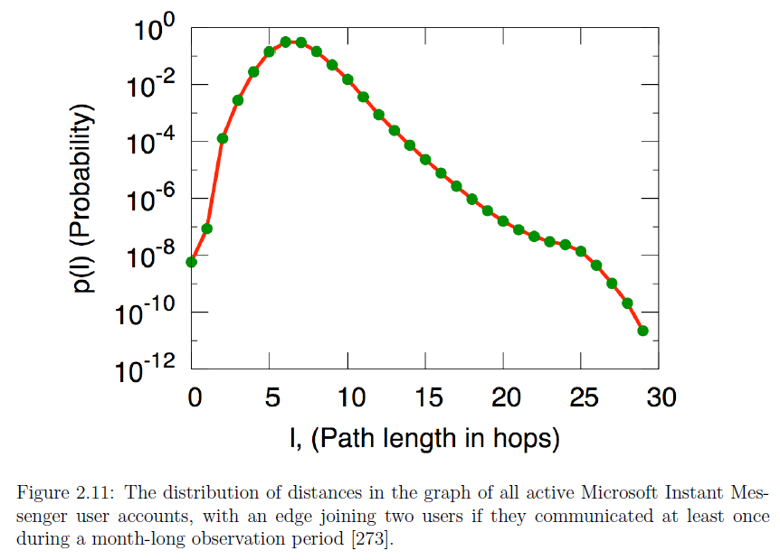
Degrees of separation? 6?
Notes:
“We randomly sampled 1000 nodes and calculated for each node the shortest paths to all other nodes. We found that the distribution of path lengths reaches the mode at 6 hops and has a median at 7. The average path length is 6.6. This result means that a random pair of nodes in the Messenger network is 6.6 hops apart on the average, which is half a link longer than the length measured by Travers and Milgram.”
Jure Leskovec & Eric Horvitz, Planetary-Scale Views on a Large Instant-Messaging Network

Slide 23
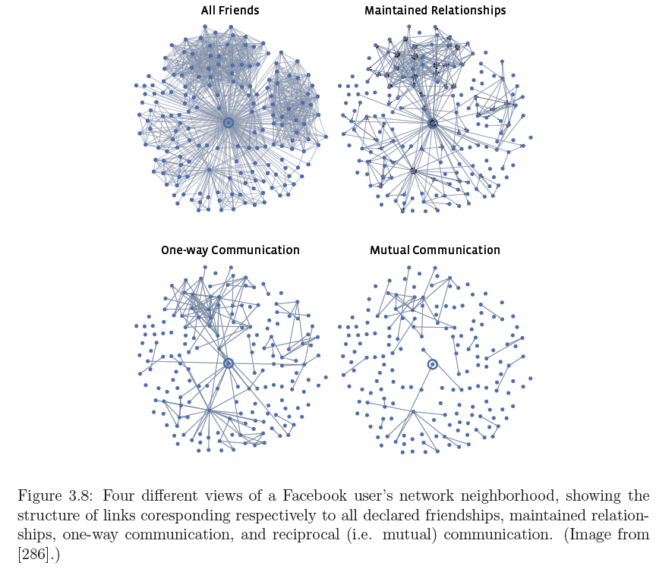

Slide 24
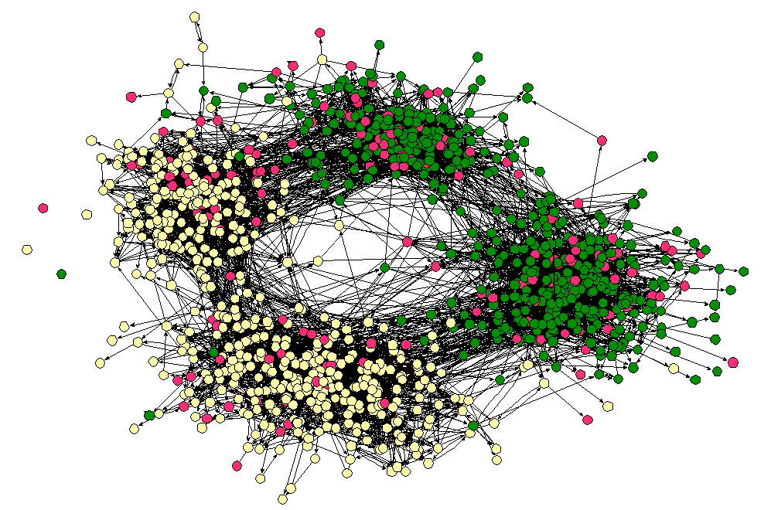
Densely-connected, homogeneous parts that are weakly connected to each other

Slide 25
Homophily in a network p = fraction of males 1 - p = fraction of females
Consider a particular edge in this network
If we independently assign each node the gender male with probability p and the gender female with probability 1-p, then both ends of the edge will be male with probability p x p = p², and both ends will be female with probability (1-p) x (1-p) = (1 - p)²
If the first end of the edge is male and the second end is female, or vice versa, then we have a cross-gender edge, so this happens with probability 2p(1-p).
Homophily test: If the fraction of cross-gender edges is significantly less than 2p(1-p), then there is evidence for homophily.

Slide 26
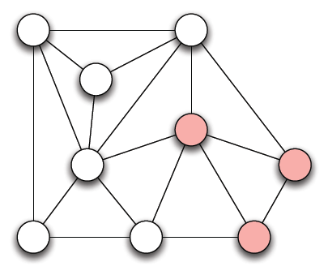
Homophily example: while males, pink females
Count 18 edges (links)
6 males, 3 females
p = 6/9 = 2/3, 1 - p =1/3
Without homophily, we should have 2p(1-p) = 4/9 = 8/18 fraction of cross-gender edges, i.e., 8 edges
But here we count only 5 of the 18 edges across genders (red)
Therefore, evidence of homophily in this network

Slide 27
Review questions
What are the defining features of a network?
What are directed graphs? Connected components?
What is a hub and spoke network? A complete network?
What is interconnection?
What is the degree of a node j?
What is degree centrality?
When does a network show homophily?

